Slide 1
COLOR MIXING LAMP
-By
Mohd Hanif Nasiruddin(20)
Ansari Bushra Zahiruddin(22)
Ansari Mohd Aquib Isar Ahmed (23)
Shaikh Tasneem Azharul (73)
Sagarika Srivastav (77)

Slide 2
CONTENTS
01
02
03
04
05
06
INTRODUCTION
COMPONENTS
CIRCUIT
WORKING
APPLICATIONS
ADVANTAGES & DISADVANTAGES

Slide 3
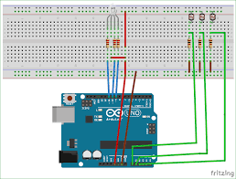
1. INTRODUCTION
What if we can generate different colors using a single RGB led and make our room’s corner more attractive?
Here is a simple Arduino based color mixing lamp which can change color when there is change in light in the room. So this lamp automatically will change its color according to the light conditions in the room.
Every color is the combination of Red, Green and Blue color. So we can generate any color by using red, green and blue colors .
Here we will vary PWM i.e., intensity of red, green and blue color in RGB LED, and different colors will be produced.
Color mixing lamp

Slide 4
How Color Mixing Lamp Is Related To Semiconductors
Semiconductors are those devices which have there conductivity lying between 10⁻⁶ S/m to 10⁴
Lately there have been many applications of semiconductors which are used in our day to day life
One of those application are color mixing lamp
Color mixing lamps works on the principle on semiconductors
Color mixing lamps uses Light Emitting Diodes (LEDs) which behave according to semiconductors

Slide 5
2. COMPONENTS
COMPONENTS | FUNCTIONS
1. RGB LEDs | Use three separate LEDs, one for each color (Red, Green, and Blue). RGB LEDs are commonly used because they allow for precise control over each color.
2. Microcontroller (MCU): | An MCU, is used to control the intensity of each color. Can be programmed to generate different colors by varying the intensity of each LED.
3. Power Supply | A power supply is needed to provide the required voltage and current for the LEDs. Make sure the power supply matches the specifications of your LEDs.
4. Transistors or MOSFETs | These are used to control the current flowing through each LED. The microcontroller sends signals to the transistors to adjust the brightness of each LED.
5. Resistors | Connect appropriate resistors in series with each LED to limit the current and protect the LEDs.

Slide 6
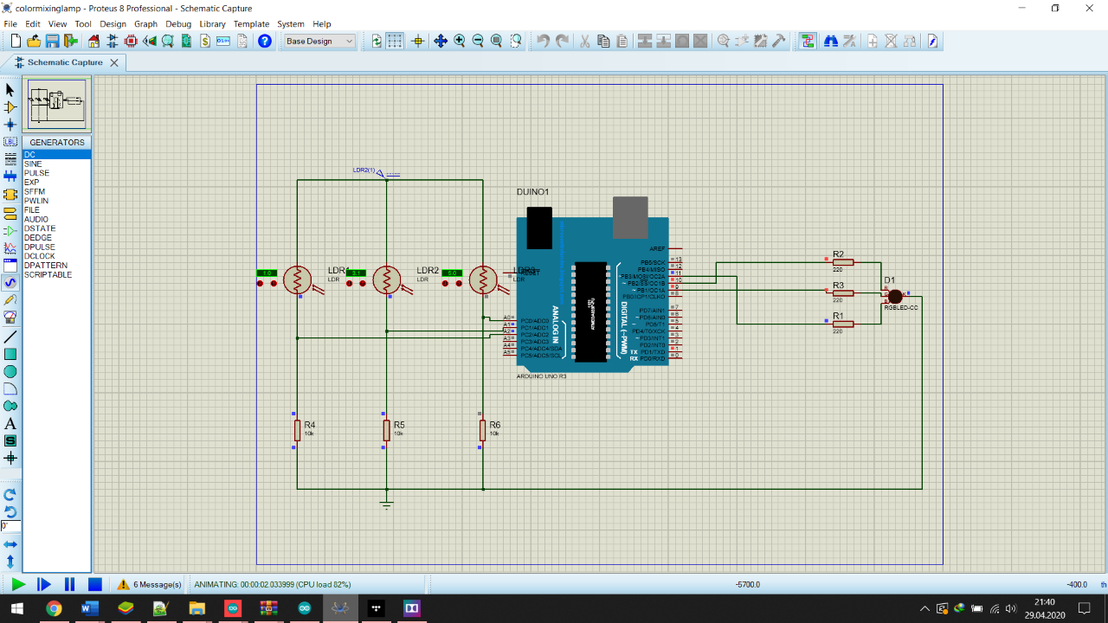
3. CIRCUIT DIAGRAM
Power Supply: Connect the positive and negative terminals of the power supply to the circuit.
RGB LEDs: Connect the anode (longer lead) of each RGB LED to the collector of a transistor or MOSFET. Connect the cathode (shorter lead) of each LED to the ground.
Transistors/MOSFETs: Connect the base (for transistors) or gate (for MOSFETs) of each transistor/MOSFET to the PWM pins of the microcontroller. This allows the microcontroller to control the intensity of each color.
Resistors: Connect a resistor in series with the anode of each LED to limit the current. The value of the resistor depends on the specifications of your LEDs.
Microcontroller: Connect the microcontroller to the transistors/MOSFETs. Program the microcontroller to produce different colors by adjusting the PWM values for each LED.
Circuit Diagram of Color mixing lamp

Slide 7
4. WORKING
The microcontroller generates PWM signals for each color
By varying the intensity of each color, the combined light creates different colors. For example, when all three colors are at maximum intensity, the light appears white. By adjusting the intensity of each color, you can produce a wide range of colors.
The user interface (buttons, knobs, etc.) can be added to control the color selection, brightness, and other features depending on the complexity of the design.
PWM signals control the transistors/MOSFETs, adjusting the current flowing through each RGB LED.

Slide 8
5. Applications
Mood Lightning: it is used in various houses to decorate and show off the beautiful colours
Photography and Videography: used to achieve specific lightning and colour tones
Educational Tools: it can used by the teachers to teach various theory related to light, colour and electromagnetic spectrum
Therapeutic Lighting: Some color mixing lamps are designed for therapeutic purposes, offering different colors to support mood regulation and alleviate certain health conditions
Retail Displays: Retailers use color mixing lamps to highlight and showcase products, creating an engaging and visually appealing shopping.
Artistic: Artists and designers use color mixing lamps to create visually stunning installations and exhibits that play with light and color

Slide 9
6. Advantages & Disadvantages
Advantages
Disadvantages
Customization: Complete control over the color and intensity, allowing to create a personalized lighting experience tailored to preferences.
Versatility: With programmable control, you can easily modify the code to implement various color patterns, transitions, or even synchronize the lamp with external events
Creative Outlet: Building your own color mixing lamp allows you to express your creativity in both the design and functionality of the lamp.
Complex Controls: Operating and programming color-mixing lamps can be complex for some users, requiring familiarity with color theory or technical knowledge.
Durability: Depending on the construction, certain color-mixing lamps may be less durable than traditional lamps, especially if they include complex electronics.
Energy Consumption: Intensive use of color-mixing features can increase energy consumption, impacting utility costs over time.

Slide 10
THANK YOU

